Slide 1
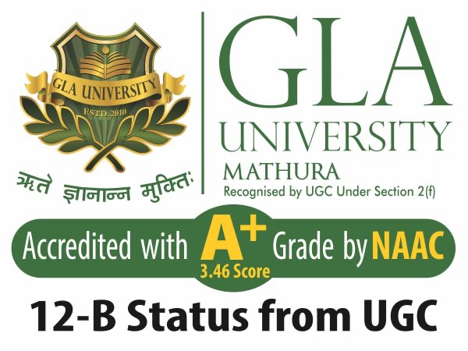
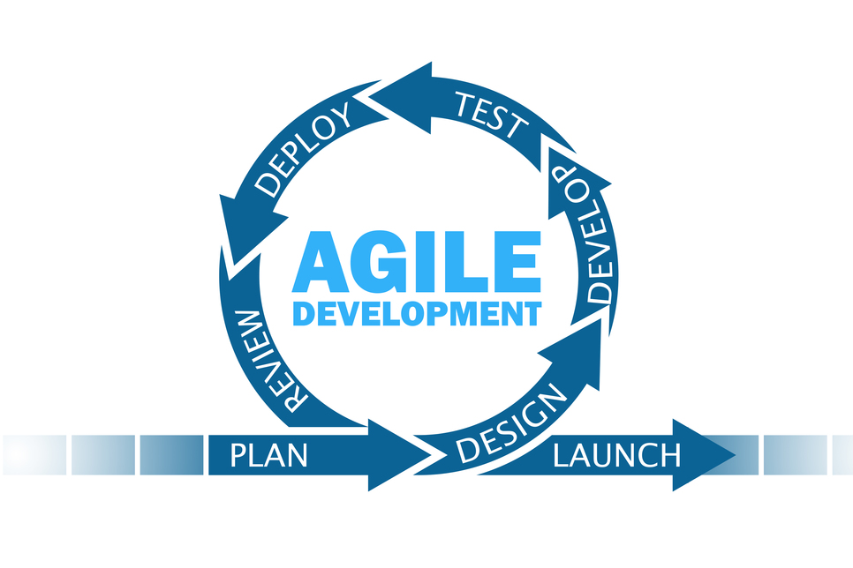
Agile Software Development
Topic: Introduction to Agile Software Development
Dr. Nikhil Govil
Associate Professor, Program Coordinator – B.Tech. (CSE), Dept. of CEA

Slide 2

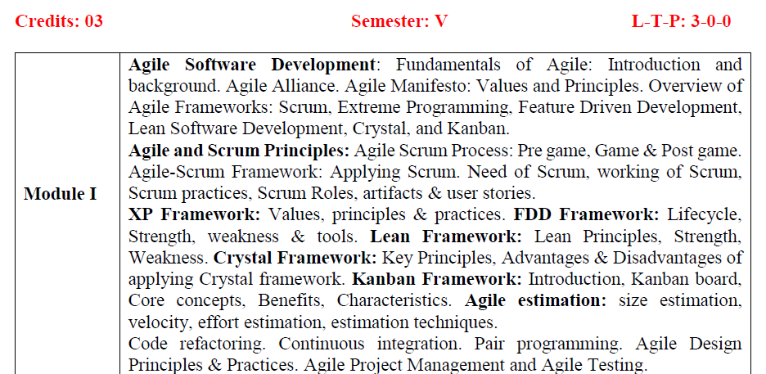
Syllabus for BCA (Hons.)

Slide 3
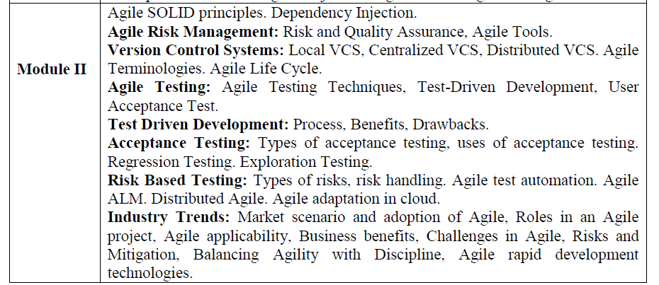
Syllabus for BCA (Hons.)

Slide 4
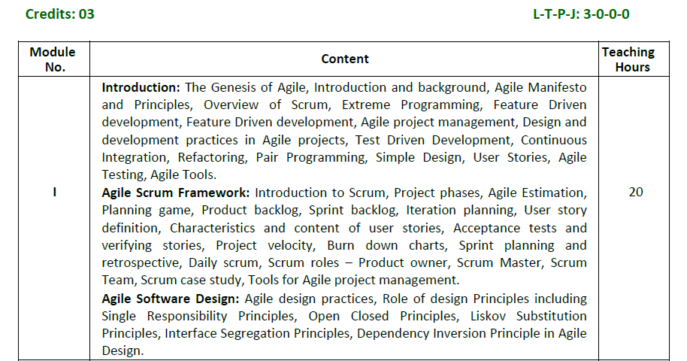
Syllabus for B.Tech. (CSE)

Slide 5
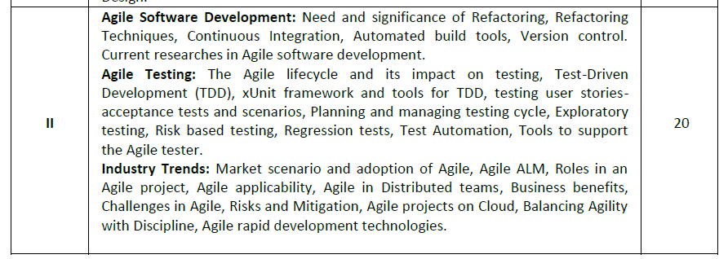
Syllabus for B.Tech. (CSE)

Slide 6
Course Objectives
To demonstrate an understanding of Agile development philosophies and methodologies,
To practice human-centric design in Agile development,
To evaluate Agile team-based practices used to create and deliver products,
To build out a small team-based project using Scrum practices,
To explore advanced and emerging topics in the domain of software development.

Slide 7
Learning Objectives
The students will be able to:
Demonstrate critical thinking while working in Agile environment,
Apply problem solving approach against a complex holistic system of Agile values, principles and practices, and challenges of scaling to the enterprise,
Describe how an Agile framework is executed from beginning to end,
Define & prioritize the system requirements in the form of User stories,
Implement a live project that adopts Agile execution techniques, etc.

Slide 8
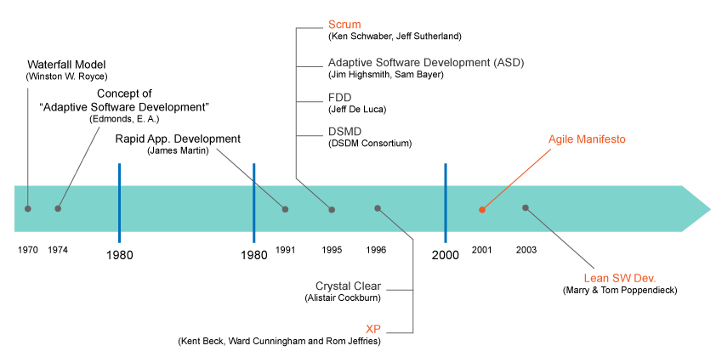
History of Agile

Slide 9
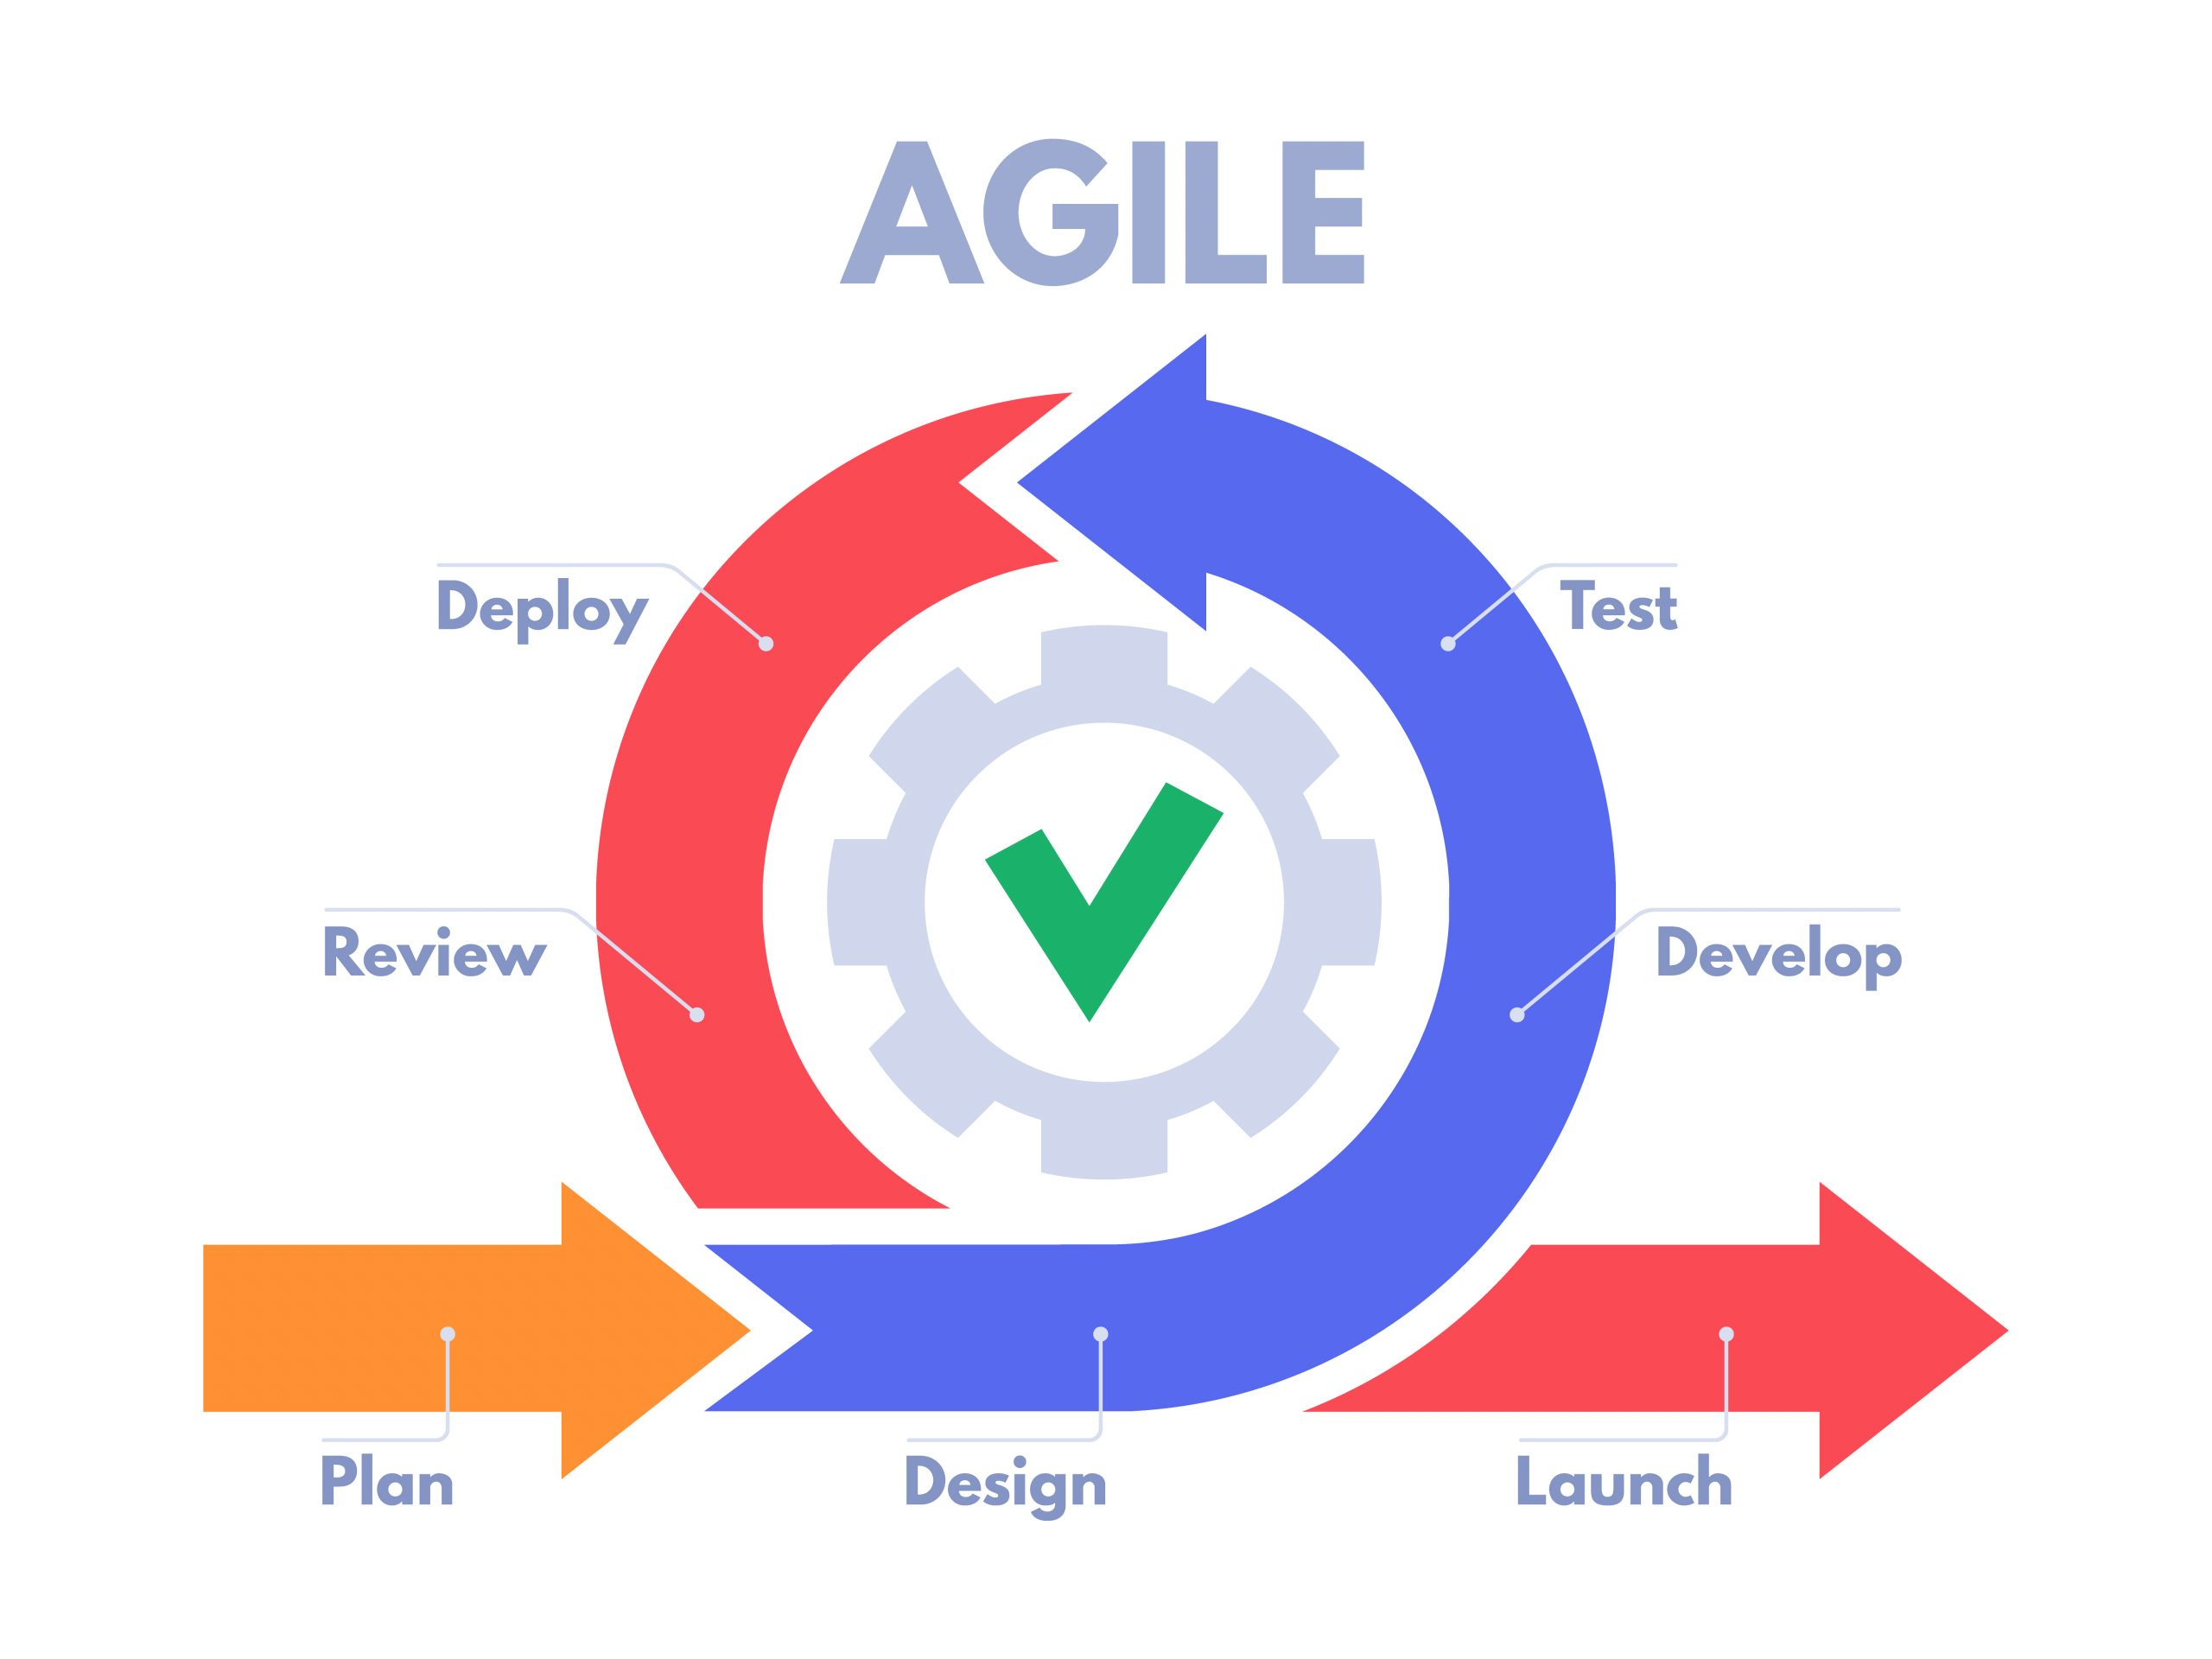
What is Agile?
Agile is a group of methodologies that demonstrate a commitment to tight feedback cycles and continuous improvement.

Slide 10
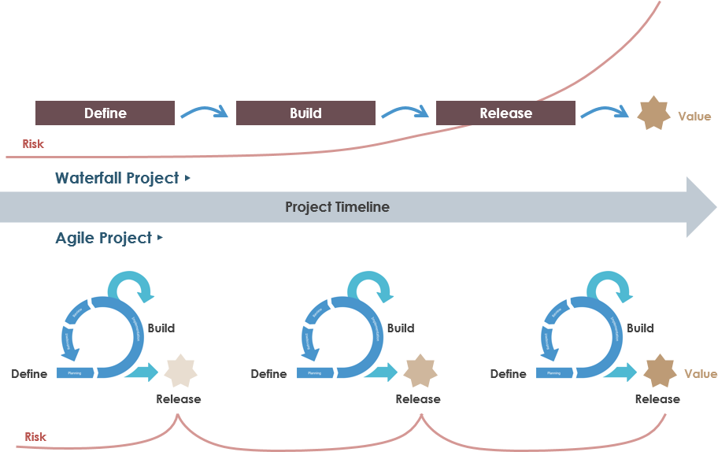
What is Agile?

Slide 11
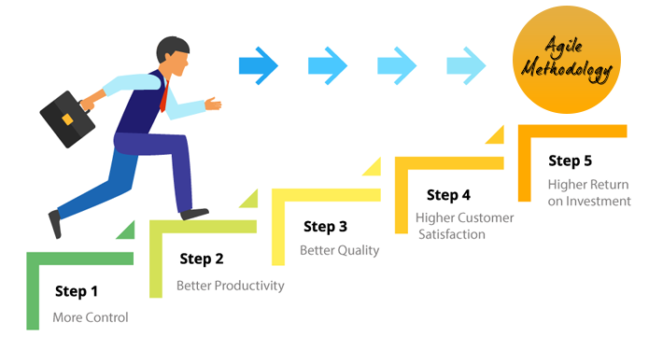
Why Choose Agile?

Slide 12
Why Study Agile?
Fun & activity based learning,
High demand of Agile professionals in IT sector,
Flexibility to break complex projects into manageable pieces,
Latest & trending SDLC model, etc.

Slide 13
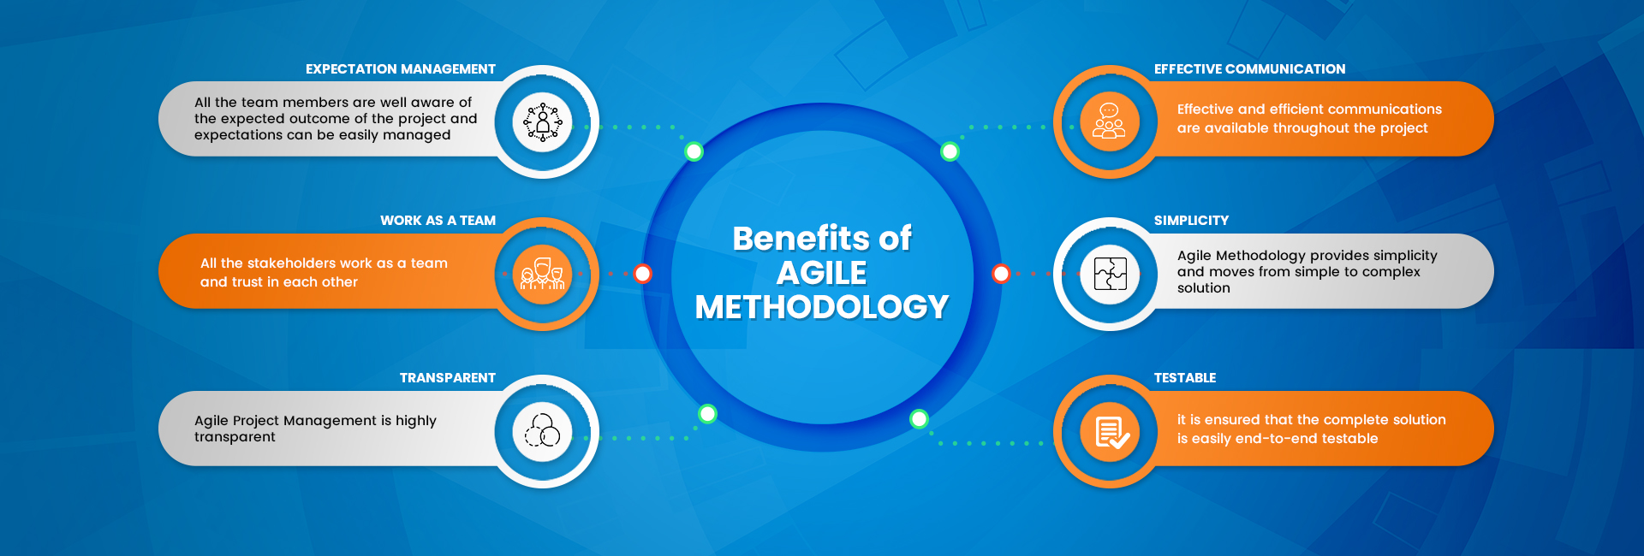
Benefits of Agile Methodology

Slide 14
Career options after learning Agile Methodologies
1. Product Owner,
2. Scrum Master,
3. Scrum Developer,
4. Quality Engineer,
5. Business Analyst,
6. Software Tester,
7. Agile Coach,
8. Enterprise Coach, etc.

Slide 15
Text & Reference Books
Ken Schawber & Mike Beedle, Agile Software Development with Scrum, Pearson, 2008.
Robert C. Martin, Agile Software Development, Principles, Patterns and Practices, Prentice Hall, 2002.
Lisa Crispin & Janet Gregory, Agile Testing: A Practical Guide for Testers and Agile Teams, Addison Wesley, 2008.
Alistair Cockburn, Agile Software Development: The Cooperative Game, Addison Wesley, 2006.

Slide 16
Trending Agile Certifications
1. Six Sigma White Belt Training & Certification [Free of Cost]
https://www.sixsigmaonline.org/six-sigma-white-belt-certification/
2. Agile Scrum Training [Free of Cost]
https://masterofproject.com/p/agile-scrum-overview-agile-scrum-certification-info
3. Agile with Atlassian Jira (from Cousera) [Paid]
https://www.coursera.org/learn/agile-atlassian-jira
4. Certified ScrumMaster (from ScrumAlliance) [Paid]
https://www.scrumalliance.org/get-certified/scrum-master-track/certified-scrummaster

Slide 17
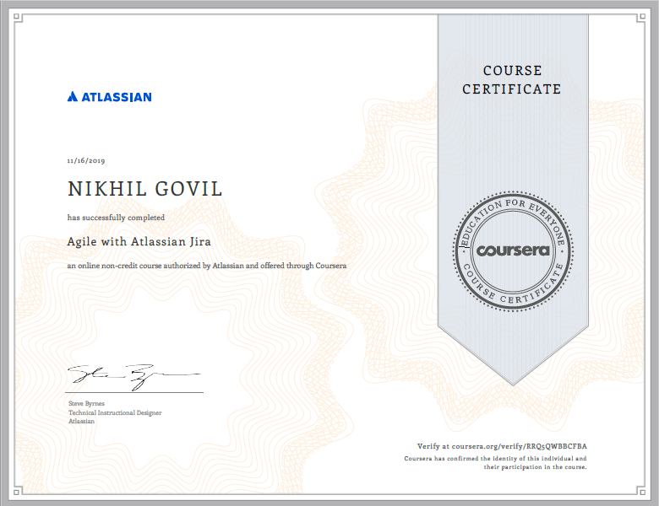
Suggested Online Course
Agile with Atlassian Jira through Coursera.

Slide 18


Slide 19


